Slide 1


Advisor : Hoon Sung Chwa
Weekly Meeting
2023.04.24
Dept of Information & Communication Engineering, DGIST
Real-Time Computing Lab
Kang Young Eun ( kye0520 @dgist.ac.kr)

Slide 2
Content
Introduction
Motivation
Model Design
Evaluation
2

Slide 3
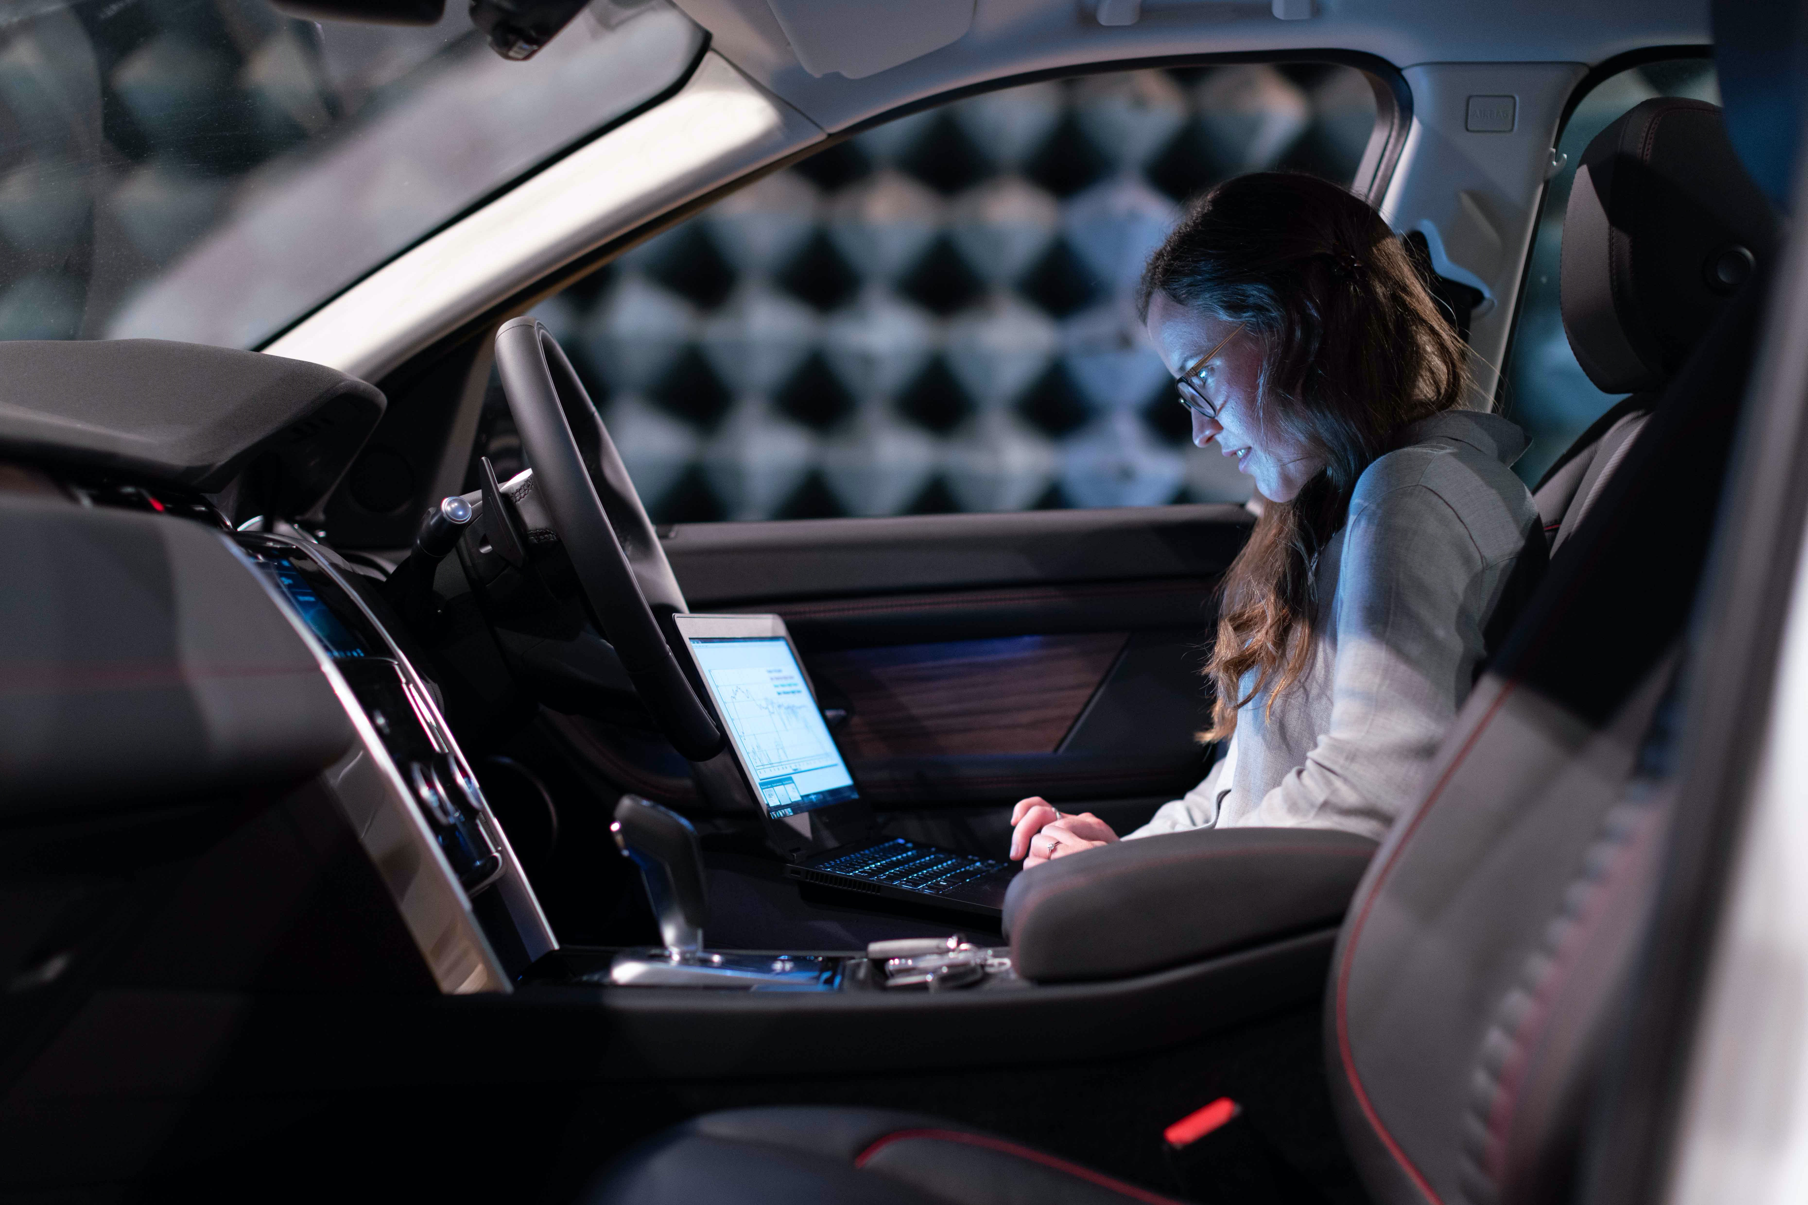
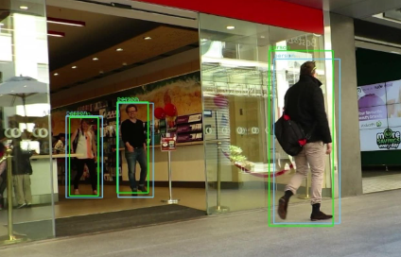
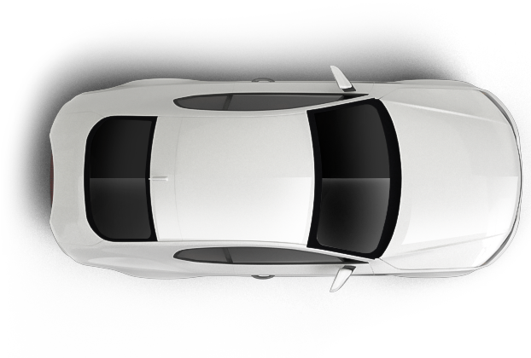
Introduction
Real time object detection in AVs
Deep Neural Network based Object detection tasks are applied.
Object detection task in AVs is critical to ensure safety of the system.
Current trend extends from traditional object detection to multi-camera object detection.
Multi camera object detection made possible to handle complex and dynamic environments capturing different perspectives of scenes.
Autonomous Vehicles
Object Detection
Multi Camera
3
Notes:
Dnn의 발전으로 많은 AV에 DNN based object detection에 적용되고 있다.
Real time object detection task는 AV의 안전을 보장하는데 굉장히 중요하다.
그리고 최근에는 기존의 traditional object detection을 넘어, 여러 대의 카메라를 활용하는 multi camera object detectio을 통하여 주변의 환경을 파악한다.

Slide 4
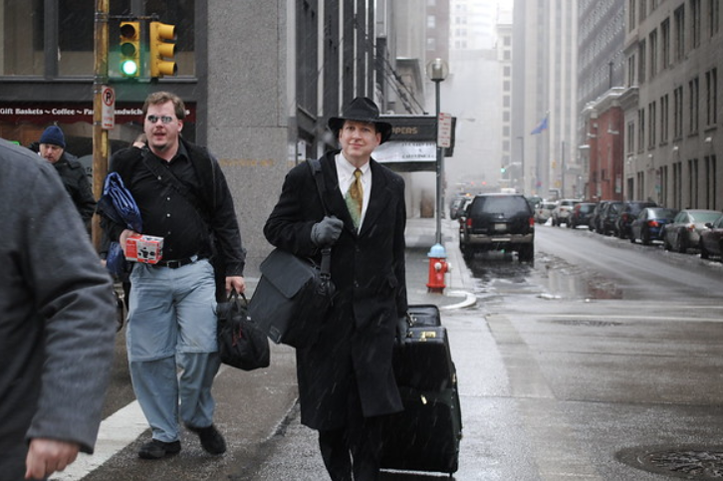
Introduction
Current DNN based Object detection tasks,
process image one at a time in a single computation cycle
compute heavy DNNs without considering the importance of the input image
does not guarantee deadline constraints
Traditional Object Detection System
Input
Output
These facts make it difficult to enhance safety of real-time object detection tasks in AVs!
4
Notes:
The current approach
1.
1.does not guarantee deadline, and all frames are processed at the same resolution regardless of their content.
2. execute computations without considering the importance of the input image, leading to unnecessary computation on unimportant regions.
3.

Slide 5
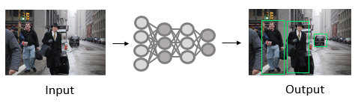
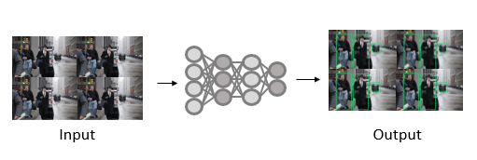
Introduction
Goal
Enhance safety of multi camera object detection system by presenting a timely object detection framework by utilizing :
Image Merge
Image Patch
Image Resize
Region-of-Interest
Deadline
59 ms
n times
90 ms
120 ms
only 1 time
Original Image Size
Enhance resource utilization
Save computation
Ensure deadline constraints
5
Notes:
따라서 syste의 goal을 3가지의 기법을 활용하여 DNN의 computatio을 줄일 수 있는 syste을 제안하여 multi camera object detection system의 안전성을 보장하는 것.
Image merge + patch와 같은 computation saving framework를 활용하여

Slide 6
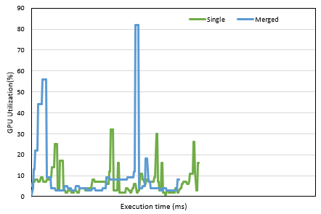
Motivation
Observation 1 : Image Merge enhances resource utilization
Resource Utilization comparison
Common Approach : Batching
GPU Utilization Comparison
Traditional
Merge
Merge utilize resource at a maximum of over 80%
6
Notes:
이와 같은 접근이 나오게 된 3가지 observation이 있다.
먼저 image merge를 통하여

Slide 7
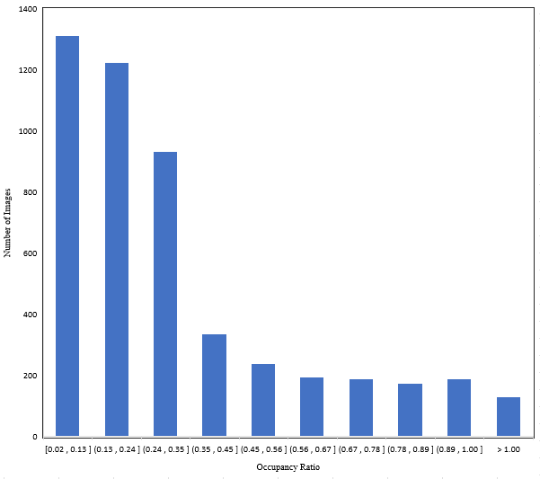
Motivation
Observation 2 : Image Patching lowers DNN computation
Proportion of Region of Interest (RoI) in an image covers a small amount
Occupancy Ratio of RoI in an image
77.8%
Lowered over 50% of original input
77% of possibility to lower computation over 50% of an image!
Therefore, image patching helps save DNN computational workload.
7
Notes:
이 문제점을 해결하기 위해서 frame에서 roi의 특성을 활용하고자 한다.
RoI 의 occupancy ratio를 측정한 결과, 이미지에서 차지하는 roi의 비중이 50%도 차지하지 않는 경우가 dataset의 77%나 되었다.

Slide 8
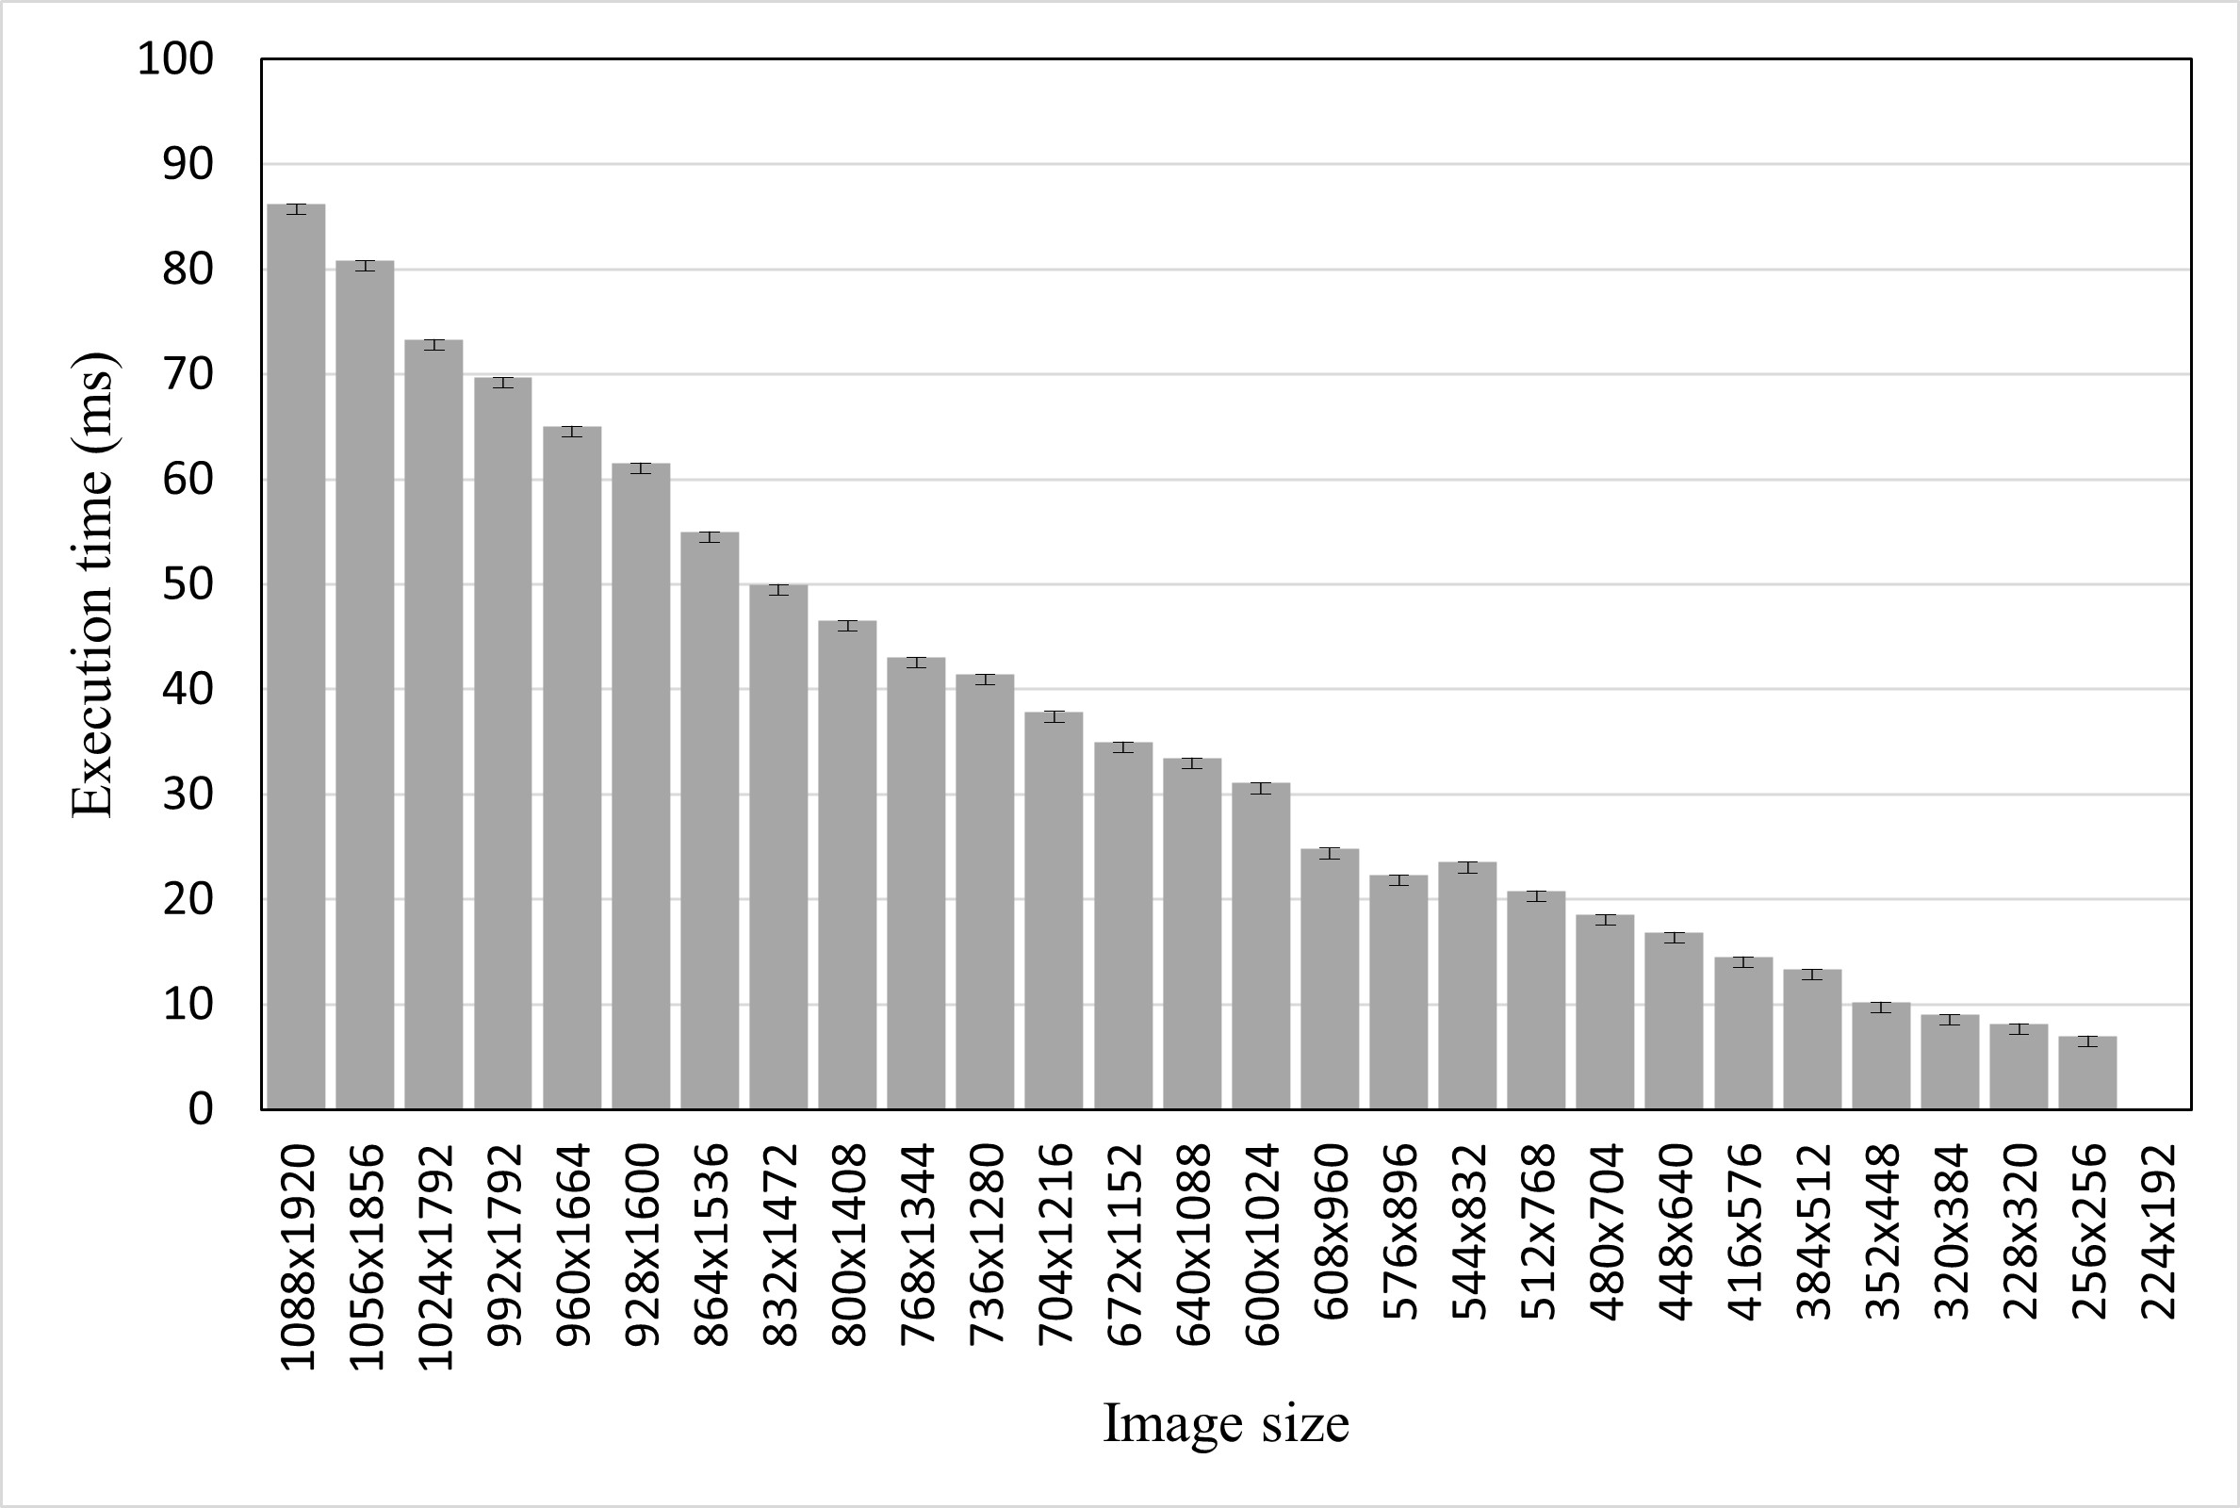
Motivation
Observation 3 : Image Resizing helps timely inferences
DNNs perform operations, such as convolution, pooling, and fully connected layers depending on the number of pixels in the image.
Therefore, execution time depends on image size.
Inference execution time with different image resolution
Therefore, resizing images helps meet task deadlines.
8
Notes:
이 문제점을 해결하기 위해서 frame에서 roi의 특성을 활용하고자 한다.
RoI 의 occupancy ratio를 측정한 결과, 이미지에서 차지하는 roi의 비중이 50%도 차지하지 않는 경우가 dataset의 77%나 되었다.

Slide 9
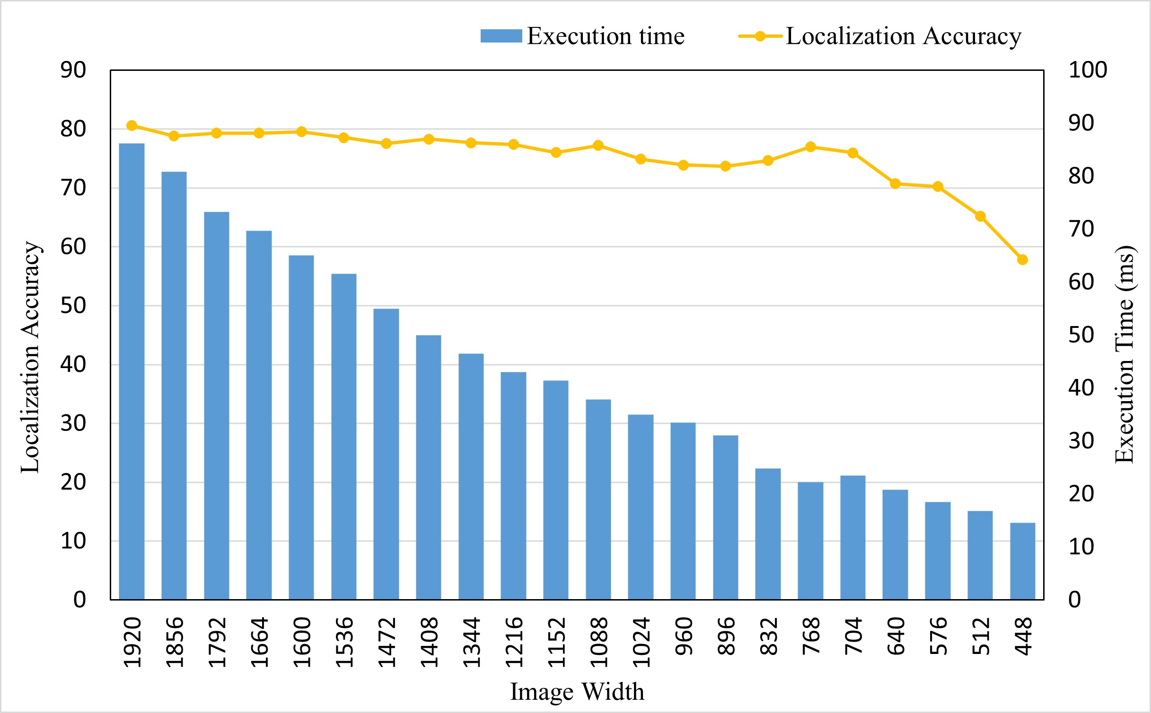
Motivation
Observation 3: Image Resizing helps timely inferences
Accuracy of Image Resizing
Impact of Localization Accuracy on image resizing with Execution time
Localization accuracy is insensitive to image downsizing.
Therefore, we apply image resizing in RoI extraction phase.
9

Slide 10
Model Design
Camera Image
Decision Module
RoI Detection
Image Merge
Object Detector
RoI result
Merge Size
1
2
Canvas Size
3
4
Bounding Box Mapping
Yolov5
Detection Result
Post Processing
Image Patching
Recursive Packing
RoI Size Decision
RoI Crop
Patch Module
10
Notes:
Merge
Patch

Slide 11
Evaluation
Evaluation
Deadline Miss Comparison
Computation workload comparison
Classification Accuracy
Breakdown latency of Patching framework
Experiment Setup
Yolov5
MOT dataset
PyTorch
Comparison Models
Vanilla : YOLOv5
11
Notes:
deadline miss ratio
Classification accuracy
Breakdown latency of patching framework

Slide 12

Advisor : Hoon Sung Chwa
Thank you
Dept of Information & Communication Engineering, DGIST
Real-Time Computing Lab
Kang Young Eun (kye0520@dgist.ac.kr)

